Slide 1


Slide 2
Introduction into Level 3 International Foundation Diploma for Higher Education Studies (L3IFDHES)
Level 3 IFDHES (from January 2024)
30.01.2024

Slide 3

Welcome
Aims:
Introduce the updated L3 IFDHES
Explore the re-developments within the qualifications
Discuss the transition to the new specifications
Highlight key information and next steps

Slide 4
Overview of Qualification L3IFDHES
The L3IFDHES qualification aims to enhance the students’ English language, mathematics, research and study skills to progress to an English-based law, finance, accounting, economics, business or engineering undergraduate degree at an internationally recognised university.
Offers pathways in law, computer science, business, engineering, health sciences and higher finance
The successful completion of the qualification should provide the student with a direct entry into the first year of a degree course at a UK university.

Slide 5

Updating our Qualifications – Why?
Reflecting Industry Changes
Alignment with Educational Standards
Compliance with Regulatory Requirements
Incorporating Stakeholder Feedback
Enhancing Accessibility and Inclusivity
Utilising Technological Advancements
Improving Assessment Strategies
Enhancing Quality Assurance Processes
Notes:
Reflecting Industry Changes: To ensure our qualifications remains relevant to current practices, technologies, and skills within industry.
Alignment with Educational Standards: To align our qualification with the latest educational standards, pedagogical approaches, and learning outcomes to enhance the quality of education provided. Increasing the number of UCAS Tariff points available to learners.
Compliance with Regulatory Requirements: To ensure the qualification meets the latest regulatory requirements and standards set by Ofqual and Qualification Wales ensure it is fit for purpose.
Incorporating Stakeholder Feedback: Act upon a range of stakeholder feedback including learners, centres, employers, and subject specialist experts, ensuring the qualification meets needs and expectations.
Enhancing Accessibility and Inclusivity: To update the qualification to be more accessible and inclusive, ensuring it is available to a diverse range of learners and supports equity in education.
Utilising Technological Advancements: Address assisted AI technology and methodologies, to improve the delivery, assessment, and administration of the qualification. Addressing the advancement to reduce the risk of malpractice and maladministration.
Improving Assessment Strategies: To update and refine assessment methods and criteria to ensure they are valid, reliable, and fair, providing an accurate measure of learner achievement.
Enhancing Quality Assurance Processes: To strengthen quality assurance mechanisms, ensuring continuous improvement in the delivery and assessment of the qualification.

Slide 6
Core Units:
What’s new?
10 Credit Units:
English for Academic Purposes
Cultural Studies
Foundation Mathematics
20 Credit Units:
Advanced English Language Skills
Study and Communication Skills
30 Credit Unit:
Developing English Language Skills
10 Credit Units:
Maths for University Study
20 Credit Units:
Developing English Language Skills
Research and Study Skills for University Study
30 Credit Unit:
New English for Academic Purposes

Slide 7
Elective Units:
What’s new?
20 Credit Units
Law for University Study 20 credits
Introductory Accounting 20 credits
Introductory Economics 20 credits
International Business 20 credits
Further Maths for University Study 20 credits
Physics for University Study 20 credits
Chemistry for University Study 20 credits
Biology for University Study 20 credits
Introduction to Programming with Python 20 credits
10 Credit Units:
New Introduction to Computer Science 10 credits
Digital World 10 credits
10 Credit Units:
Introduction to Accounting and Economics
Introduction to Business
Further Mathematics
Physics
Chemistry
Biology
Introduction to Programming

Slide 8

Benefits to learners:
Enhanced Relevance
Improved Skill Development
Increased Engagement and Opportunities
Flexibility
Better Preparation for Higher Education
Enhanced Accessibility and Inclusivity
Improved Assessment Methods
Global Recognition
Notes:
Enhanced Relevance: Updating the specification ensures that the content is aligned with current academic and industry trends, making the learning more relevant and applicable to real-world scenarios. This can significantly improve learners' readiness for higher education or employment in their chosen fields.
Improved Skill Development: By incorporating the latest educational methodologies and focusing on skills demanded by higher education institutions and employers, such as critical thinking, problem-solving, and digital literacy, learners can develop a more robust skill set that enhances their overall competency.
Increased Engagement: Modernizing the curriculum with interactive and engaging learning materials and methods can lead to a more stimulating learning environment. This may include the use of digital tools, collaborative projects, and practical applications of theoretical concepts.
Better Preparation for Higher Education: With a focus on the essential knowledge and skills required for success in higher education, the updated specification can better prepare learners for the rigors of undergraduate study, including research, academic writing, and independent learning.
Enhanced Accessibility and Inclusivity: Updates might also focus on making learning more accessible and inclusive, catering to a diverse learner demographic. This could involve introducing adaptive learning technologies, flexible study options, and support resources for learners with different needs and backgrounds.
Improved Assessment Methods: Revamping the assessment strategies to align with current best practices can provide a more accurate and comprehensive evaluation of learners' abilities and progress. This might include a mix of formative and summative assessments, portfolio work, and practical projects that reflect real-world tasks.
Global Recognition: Ensuring the qualification meets international standards can enhance its recognition and acceptability by universities and employers worldwide, opening up broader opportunities for learners.
Focus on Career Readiness: Including content and skills specifically tailored to improve employability, such as communication skills, teamwork, and leadership, can make learners more attractive to potential employers and better equipped for the workplace.
Cultural Sensitivity and Global Awareness: An updated curriculum that reflects a global perspective and cultural sensitivity can prepare learners for studying and working in an increasingly interconnected world, fostering a deeper understanding of diverse cultures and global issues.

Slide 9

Entry Requirements:
Students must meet the following entry requirements:
Completed their GCSE/IGCSE ‘O’ Levels or an equivalent* qualification in their own country and passed 5 subjects with minimum grades of ‘C’, ‘4’ or equivalent* in each. These should include Mathematics and English.
Have a valid score of 4.5 or above in the International English Language Testing System (IELTS) examination or equivalent for students whose first language is not English. Alternatively, students can take the free NCC Education Standard English Placement Test which is administered by our Accredited Partner Centres.
* Centres need to provide evidence to justify any equivalency decision (both qualification equivalency and grade equivalency) they make pertaining to any enrolments via non-GCSE or non-standard routes.

Slide 10
Entry Requirements cont…:
Completed their GCSE/IGCSE ‘O’ Levels or an equivalent* qualification in their own country and passed 5 subjects with minimum grades of ‘C’, ‘4’ or equivalent* in each. These should include Mathematics and English.
NCC Education country by country entry criteria guidance
Centres need to provide evidence to justify any equivalency decision (both qualification equivalency and grade equivalency) they make pertaining to any enrolments via non-GCSE or non-standard routes.

Slide 11
Entry Requirements cont…:
Have a valid score of 4.5 or above in the International English Language Testing System (IELTS) examination or equivalent for students whose first language is not English.
English language requirements:
NCC Entry Requirement | NCC | IELTS | TOEFL | Password | PTE Academic | Skills for English | CEFR | Duolingo
 |  | 9.0 | 118 – 120 |  | 86+ | C2 Pass | C2 | 155 – 160
 |  | 8.5 | 115 – 117 |  | 83 – 85 | C2 Pass | C2 | 145 – 150
 |  | 8.0 | 110 – 114 |  | 79 – 82 | C1 Pass | C1 | 135 – 140
 |  | 7.5 | 102 – 109 | Password Plus | 73 – 78 | C1 Pass | C1 | 125 – 130
 |  | 7.0 | 94 – 101 | 7.0 | 65 – 72 | C1 Pass | C1 | 115 – 120
 |  | 6.5 | 79 – 93 | 6.5 | 58 – 64 | B2 Pass | B2 | 105 – 110
 |  | 6.0 | 60 – 78 | 6.0 | 50 – 57 | B2 Pass | B2 | 95 – 100
L3DC/L4DC/L5DC | HEPT 40% | 5.5 | 46 – 59 | 5.5 | 42 – 49 | B2 Pass | B2 | 85 – 90
 |  | 5.0 | 35 – 45 | 5.0 | 36 – 41 | B1 Pass | B1 | 75 – 80
L3IFDHES | SEPT 40% | 4.5 | 32 - 34 | 4.5 | 30 - 35 | B1 Pass | B1 | 65 - 70
Centres need to provide evidence to justify any equivalency decision based on English language requirements if not stated above.

Slide 12
Entry Requirements cont…:
Alternatively, students can take the free NCC Education Standard English Placement Test which is administered by our Accredited Partner Centres.
For learners who do not hold a valid IELTS certificate:
Pass the NCC Education Standard English Placement Test (SEPT) and achieve 40% or above for students to be accepted on the L3IFDHES – IELTS 4.5 equivalent
Pass the NCC Education Higher English Placement Test (HEPT) and achieve 40% or above for students to be accepted on the L3IFDHES - IELTS 5.5 equivalent

Slide 13
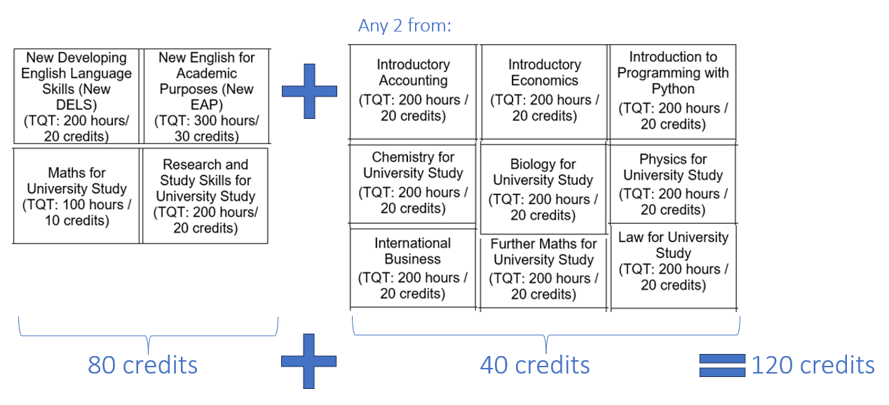
Student options:
Student pathways: Group 1 candidates (for 4.5 ≤ IELTS (or equivalent) < 5.5):
4 core + 2 elective (both 20-credit)

Slide 14
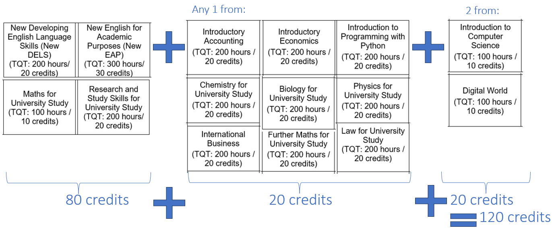
Student options:
Student pathways: Group 1 candidates (for 4.5 ≤ IELTS (or equivalent) < 5.5):
4 core + 1 elective (20-credit) + 2 elective (10-credit)

Slide 15
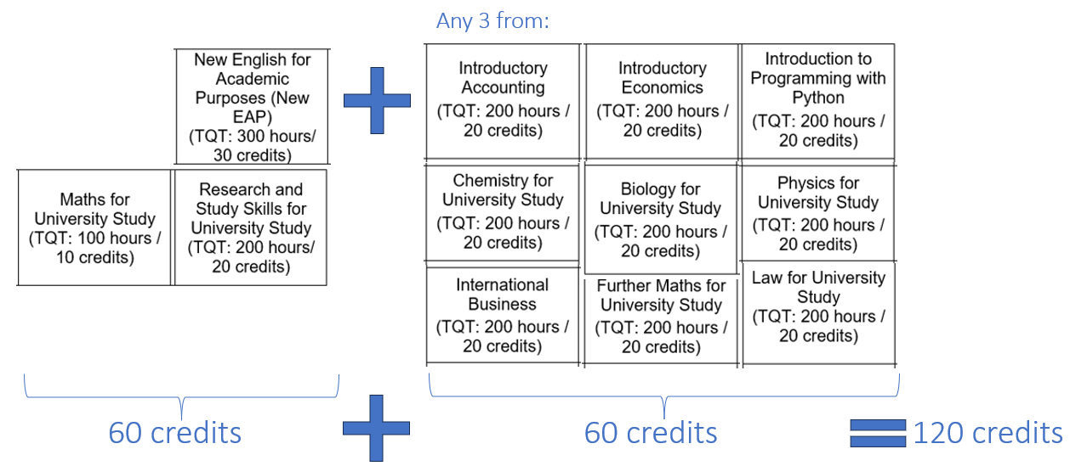
Student options:
Student pathways: Group 2 candidates (for IELTS (or equivalent) ≥ 5.5):
3 core + 3 elective (all 20-credit)
Notes:
Example c by c equiiancy

Slide 16
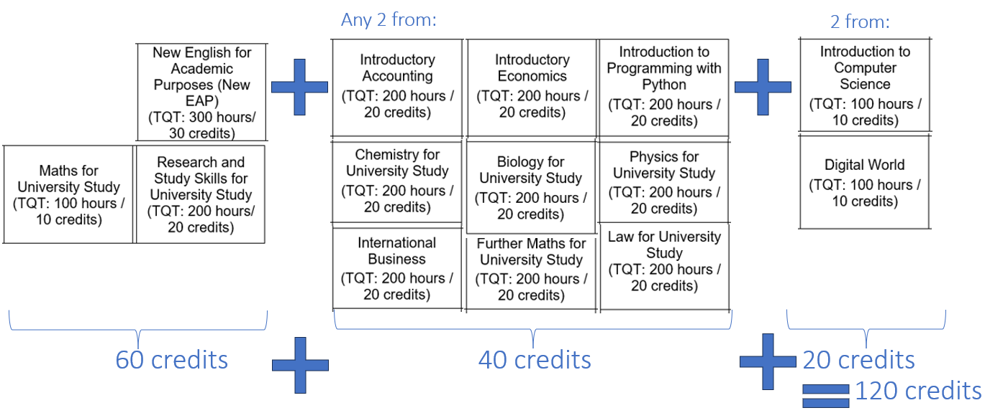
Student options:
Student pathways: Group 2 candidates (for IELTS (or equivalent) ≥ 5.5):
3 core + 2 elective (20-credit) + 2 elective (10-credit)

Slide 17
Unit changes – core:
Unit | Credit | Assessment Method | Changes
Developing English Language Skills | 20 | 100% Local exam | New content, slides for all lessons and more flexibility
English for Academic Purposes | 30 | 75% Local exam 25% Global assignment | New content, slides for all lessons and more flexibility
Maths for University Study | 10 | Exam 1: 35% Global exam Exam 2: 65% Global exam | New content
Research and Study Skills for University Study | 20 | 75% Global assignment 25% Local exam | Current and up to date content with new content added

Slide 18
Unit changes – electives:
Unit | Credit | Assessment Method | Changes
Law for University Study | 20 | 100% Global assignment | New unit
Introductory Accounting | 20 | Exam 1: 25-50% Global exam Exam 2: 50-75% Global exam | Split unit with new content
Introductory Economics | 20 | Exam 1: 25-50% Global exam Exam 2: 50-75% Global exam | Split unit with new content
International Business | 20 | 60% Global assignment 40% Global exam | Current and up to date content with new content added
Further Maths for University Study | 20 | Exam 1: 45% Global exam Exam 2: 55% Global exam | New content
Physics for University Study | 20 | Exam 1: 70% Global exam Exam 2: 30% Global exam | New content
Chemistry for University Study | 20 | Exam 1: 50% Global exam Exam 2: 50% Global exam | New content
Biology for University Study | 20 | Exam 1: 50% Global exam Exam 2: 50% Global Exam | New content
Introduction to Programming with Python | 20 | 30% MCQ + 70% Global Assignment | Programme language changed form Visual Basic to Python
Introduction to Computer Science | 10 | 30% MCQ + 70% Global Assignment | New content
Digital World | 10 | 30% MCQ + 70% Global Assignment | New unit

Slide 19

Transition to the new specifications:
12 months transition from the 1st March 2024
Operation end date current specifications will be 28th February 2025
Last assessment cycle – Winter 2027 (including re-sits)
No in year transfer
Progressions
Notes:
Centres will have 12 months to transition to the new specification from the 1st March 2024.
The operational end date for the current specifications will be 28th February 2025. From this date no new students can be enrolled.
Re-sits -
Students must complete the qualification they are enrolled on and cannot transfer to the new specification during their academic year. For example, a student taking the L4 Diploma in Computing on the current specification cannot transfer to the new specification in the same year of study i.e. change versions during the year.
Students will have a 3 year eligibility to complete their qualification. During this time if a student leaves and returns to the same qualification, they will be able to take the assessments based on the specification they were originally enrolled on. The last assessment cycle for our current specifications will be Winter 2027.
Students can progress from existing to new qualifications from level to level. For example, a student enrolled onto the current L3 Diploma in Computing, once achieved, can progress onto the L4 Diploma in Computing with the new specification.

Slide 20

Next Steps:
From the 1st February 2024 centres will be able to access the VLE with the following resources available:
  Entry criteria guidance
  Transition guide – moving specification
  Key dates
  Activity schedule updates for the remainder of 2024
  Links to support and training

Slide 21
Next Steps Cont..:
On the 26th February 2024:
  Centres can access all specifications and teaching, learning and assessment materials via the VLE
  Centres can enrol learners onto Quartz
  Centres can commence delivery
  Marketing kit will be provided

Slide 22
Thank you for joining today!
If you have any questions, please use the forms below:
L3IFDHES Centre Feedback

Slide 23

Head Office UK
Regional Offices
NCC Education UK
Second Floor, Adamson House Towers Business Park Wilmslow Road
Didsbury Manchester M20 2YY
United Kingdom
t : +44 (0) 161 438 6200
e : customer.support@nccedu.com
CHINA
Beijing
t : +86 (0) 10 6520 4030
MALAYSIA
Kuala Lumpur
t : +60 (0) 11 6339 6200
e : nccedu.my@nccedu.com
AFRICA
Cape Town
e : customer.support@nccedu.com

